Slide 1
Game of Thrones
Data Analytics Perspective

Slide 2
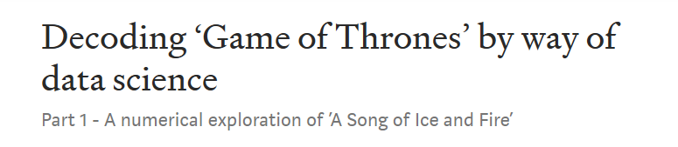

https://blog.usejournal.com/decoding-a-game-of-thrones-by-way-of-data-science-fd81e66d1255

Slide 3
Data Science for Literature?
However, this article is not a literary critics review, but rather a data science exploration.
This numerical exploration will form a stepping stone into a follow-up article where we will see
how machine learning can construct different non-deterministic representations of the books.
Are there patterns that can predict future events in the books and television series?
Can novelist and screenwriters of the future use artificial intelligence to generate new material,
enabling a book to be written in weeks instead of years? Martin’s last published novel,
‘A Dance With Dragons’, took six years to write, having HBOs television series outpace the
books already by season six. But now we are running ahead of ourselves!
This article covers concepts from natural language processing. Natural language processing
is an interdisciplinary field which aims to process large amounts of natural language data
using computer programming.

Slide 4

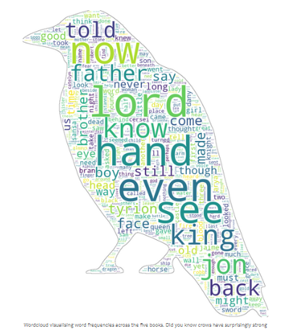
WordCloud: Across 5 Books
Numerical exploration:
Measuring the lexical diversity to evaluate the lexical richness
Character footprints and word frequency analysis of the story line
Calculating the importance of the characters using network theory

Slide 5
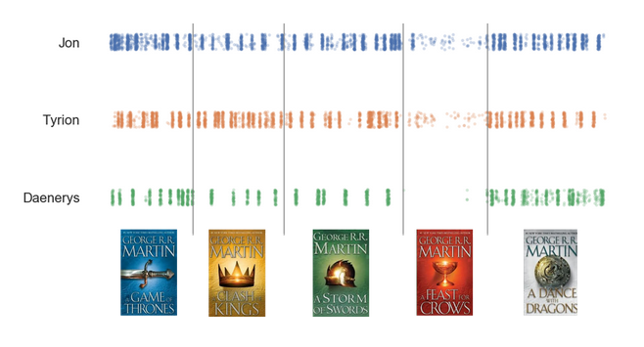
Names in Books: Character Footprints

Slide 6
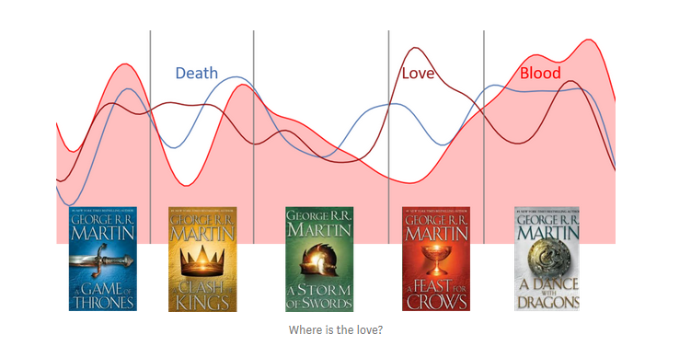
Word Frequencies

Slide 7
IMPLICATIONS
?

